Slide 1
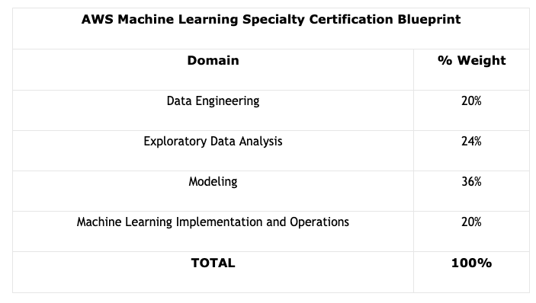

AWS Machine Learning Specialty Certification Exam
Course Outline

Slide 2
AWS Machine Learning Foundational Concepts
Terminology
Model
Random Cut Forest
Algorithm
GPU
One-Hot-Encoding
Inference
Blazing Text
Data Streams
Confusion Matrix
Transformer
XGBoost

Slide 3

AWS Machine Learning Data Engineering Concepts
Basic data engineering concepts and terminology
Creating data repositories for machine learning
Identifying and implementing data-ingestion and data-transformation solutions
AWS data migration services and tools

Slide 4





AWS Machine Learning Exploratory Data Analysis Concepts
Basic data analysis concepts and terminology
Kinesis Data Streams
Kinesis Data Firehose
Kinesis Video Streams
Kinesis Data Analytics
Sanitize and prepare data for modeling
Feature engineering
Visualize data for machine learning

Slide 5




AWS Machine Learning Modeling Concepts
Select the appropriate model(s) for a given machine learning problem
Train machine learning models
Tune and optimize hyperparameters
Evaluate effectiveness of machine learning models

Slide 6
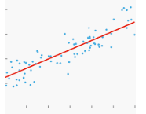
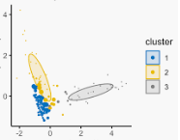
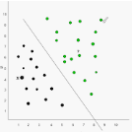

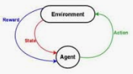
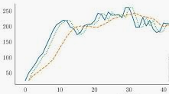
AWS Machine Learning Algorithm Concepts
Basic algorithm concepts
Types of algorithms
Regression
Clustering
Classification
Image Analysis
Anomaly Detection
Text Analysis
Reinforcement Learning
Forecasting

Slide 7
AWS Machine Learning Implementation and Operations Concepts
Modeling concepts
Building machine learning solutions that are performant available scalable resilient and fault tolerant
Recommending and implementing the appropriate machine learning services and features for a given problem,
Applying AWS security best practices to your machine learning solutions
Deploying and operationalizing your machine learning solutions

Slide 8
AWS Machine Learning Course Summary and Exam Tips
Course summary
Exam day details and tips
Section quiz

